Slide 1
Working with providers & can they waive their responsibilities
Gemma Periam
eotcsupport@eonz.org.nz

Slide 2
Karakia

Slide 3
Engaging external providers
When schools engage an external provider to deliver EOTC to their ākonga, both school and provider must be crystal clear on their respective and shared responsibilities.

Slide 4
Having a safety culture
Everyone has responsibility for safety
Don’t think “Do I have a responsibility?”
Think “What is it I am responsible for?”
Consult – Cooperate – Coordinate = COMMUNICATION

Slide 5
What are your arrangements with providers?
Task:
List all the EOTC Providers your school uses
For each summarise the arrangements you have in place with them regarding your respective responsibilities for learning/instruction, supervision, and emergency response

Slide 6
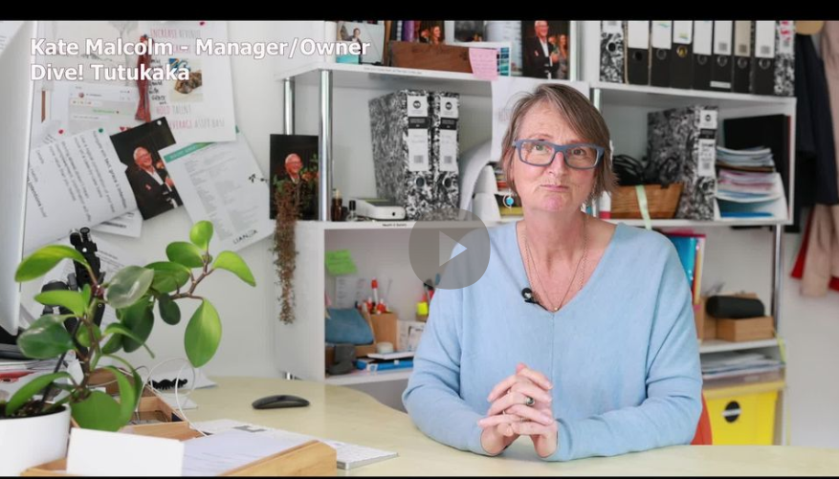
Dive!Tutukaka Lessons Learnt
Working with Schools
Dive!Tutukaka has been held accountable for their role in the Tararoa Area School incident
Lessons Learnt video clip provides a very good explanation of the shared responsibility requirement when schools and providers work together.

Slide 7
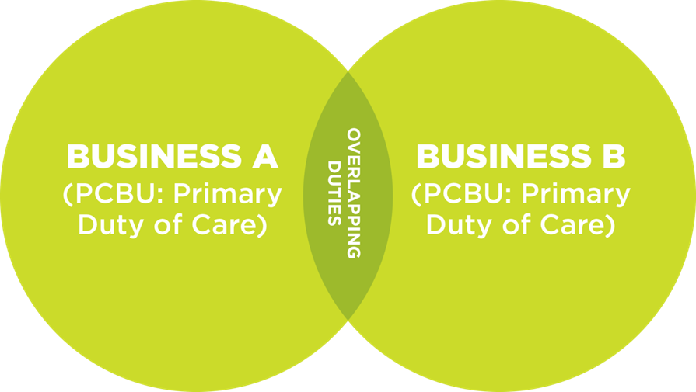
PCBU HAS A DUTY TO CONSULT, COOPERATE AND COORDINATE
School
Provider
PCBUs must discharge their duty to the extent possible based on ability to influence and control the matter
Notes:
Overlapping duties and CCC
Because PCBUs have duties to workers affected by their work, not just to those they directly employ or engage, PCBUs may well have overlapping duties.
A school camp where staff from the school work alongside provider staff to run activities is an obvious one.
GET GROUP TO PROVIDE OTHER EXAMPLES
In this case, all PCBUs in the workplace have a duty to consult, cooperate and coordinate on health and safety matters. This is a fundamental part of the Act’s design that ensures that all PCBUs work together for the health and safety of everyone in the workplace.
All the provider has to do is provide evidence of their registration, however the robust conversation must occur around what and when and whose systems we are operating.
Limitations
However, the Act recognises that PCBUs with shared duties have different influences over health and safety matters, so the extent of a PCBU’s duty depends on its level of influence and control.
In practice this means that the measures a PCBU should take in relation to its own employees and contractors are likely to be different from the measures which it should take in relation to the employees and contractors of another PCBU. This is because it will have less influence and control over the workers of another PCBU.
It is not ‘all or nothing’ the degree of responsibility will be affected by the level of influence and control a PCBU has over the situation. Remember not ‘do I have a responsibility” but “what is my responsibility”.
********************************************************************
Here is the exact wording from the Act
33 More than 1 person may have same duty
(1) More than 1 person may have the same duty imposed by or under this Act at the same time.
(2) Each duty holder must comply with that duty to the standard required by or under this Act even if another duty holder has the same duty.
(3) If more than 1 person has a duty for the same matter, each person—
(a) retains responsibility for that person’s duty in relation to the matter; and
(b) must discharge that person’s duty to the extent to which the person has the ability to influence and control the matter or would have had that ability but for an agreement or arrangement purporting to limit or remove that ability.

Slide 8
Multiple PCBUs with overlapping duties
Different businesses working together on the same project eg construction on school grounds, school camps or EOTC experiences
PCBUs need to consult, co-operate and co-ordinate activities to meet shared responsibilities
Extent of PCBU’s duty depends on its level of influence and control over workplace H&S
Less influence and control over workers of another PCBU
Need to make arrangements with the PCBU that’s closer to the work
(Ministry of Education www.education.govt.nz/)
Notes:
Many work situations involve multiple PCBUs that have overlapping duties, eg there may be a number of different businesses working together or alongside each other on a single work site, such as a construction site, and through contracting (eg EOTC activities) or supply chains. The current legislation already covers this, so the need for PCBUs to work together to meet their duties is not new.
PCBUs will need to consult, co-operate, and co-ordinate activities to meet their shared responsibilities. They should make reasonable arrangements and coordinate responsibilities with the other PCBUs to fulfil their duty and they should also monitor each other to ensure everyone is doing what they agreed. This could be set out in contractual arrangements between PCBUs (eg between the school and an adventure activity operator).
The extent of a PCBU’s duty depends on the level of influence and control the PCBU has over health and safety at the workplace where there are multiple PCBUs.
The measures a PCBU will take for its own staff are likely to be different from the measures which it can take for employees of another PCBU, as it will have less influence and control over the workers of another PCBU. A PCBU that has less direct control and influence is more likely to fulfil its duty by making arrangements with the PCBU that is closer to the work.
For example, the school Board of Trustees will have less influence and control over the workers of construction, electrical, or plumbing companies who are building new classrooms at a school. The Board of Trustees will need to arrange with these companies to ensure their health and safety measures ensure the safety of their workers and do not cause any health and safety issues for the school’s staff or students.

Slide 9
How do we set up the relationship?
External Provider Agreement form 6
Remember: CONSULT – COOPERATE - COORDINATE!!!
and DOCUMENT
See also
EOTC Zoom series (Working with Providers)

Slide 10
Waivers
Discuss in a small group. What examples have you seen where providers have waived responsibility, or said “we do not take responsibility for…”?
“NZ law doesn’t allow an operator to contract out of their responsibilities. Use of terms such as ‘waiver’ or ‘release’ give the appearance that the operator won’t take the responsibility for client safety that they’re legally required to do.” (Stu Allan, Chairperson, Register of Safety Auditors (ROSA))
Refer: EOTC Coordinator Update – Term 1 2024.

Slide 11
Notes:
Te whakaeatanga e
Te whakaeatanga e
Tēnei te kaupapa ka ea
Tēnei te wangana ka ea
Te mauri o te kaupapa ka whakamoea
Te mauri o te wāngana ka whakamoea
Koa ki runga, koa ki raro
Haumi e, hui e, taiki e
It is completed, it is done,
we have achieved our purpose, completed our forum,
let the purpose of our gathering rest for now,
let the vitality of our discussions replenish,
we depart with fulfilled hearts & minds,
bonded in our common goal & unity

Slide 12
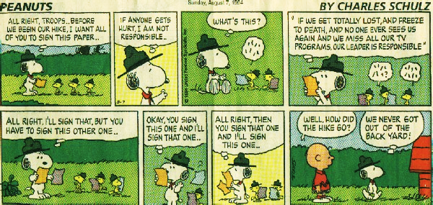
“More food for thought...”

