Slide 1
A Games Based Approach to Developing Game Sense
Adam Wilson - Mount Roskill Grammar School
adam.wilson@mrgs.school.nz

Slide 2
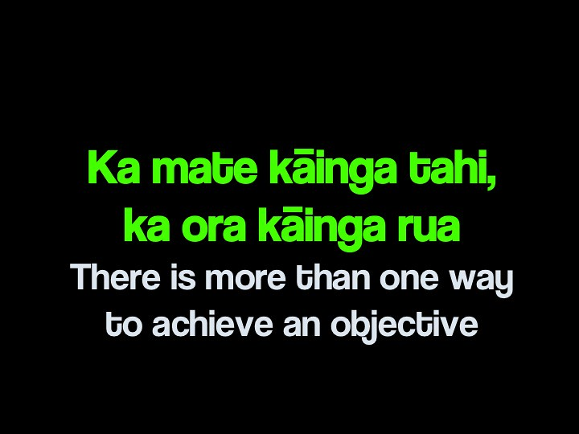
9SPP
Whakatauki
(9SPP - Sports Performance)

Slide 3
How science and data has changed how we train for sport
Learning Intentions:
We are learning how to use data and technology to help develop ‘Game Sense’.
We are learning about how science and data has transformed the way in which we can develop ‘Game Sense’.
Success Criteria:
I can IDENTIFY how I could use data and technology to help develop ‘Game Sense’.
I can EXPLAIN how the use of data and technology has changed the way in which many activities are played.

Slide 4
Quick Question - How do you currently develop Game Sense / Tactical understanding with your students?
01
Discuss your own experiences with the people around you.

Slide 5
Quick Question - What do your students think about when ‘playing’ (Before / During / and When off the court??
02
Discuss with the people around you.

Slide 6
How science and data has changed how we train / play
Background Reading - - - - - - - - - - >

Slide 7
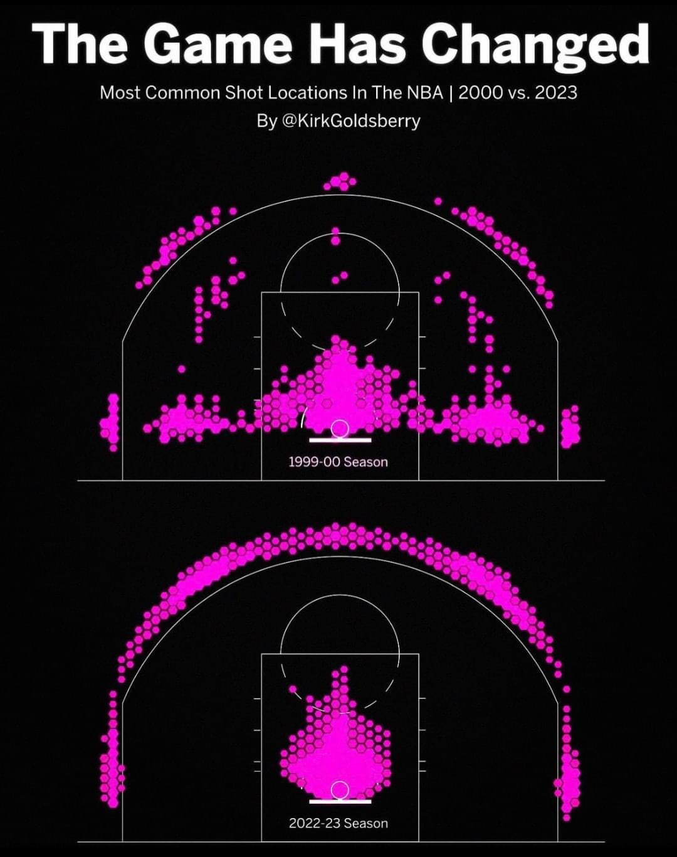
Some Background Reading if interested in knowing more…
01 Developing Game Sense…
03 GPS Trackers in Sport
02 Using a delayed video feed…
04 Basketball Shooting example…
Let's talk about Game Sense
GPS Trackers in Sport
Incorporating delayed video into training - Coaching Volleyball
NBA heat maps by play type - Synergy Sports

Slide 8
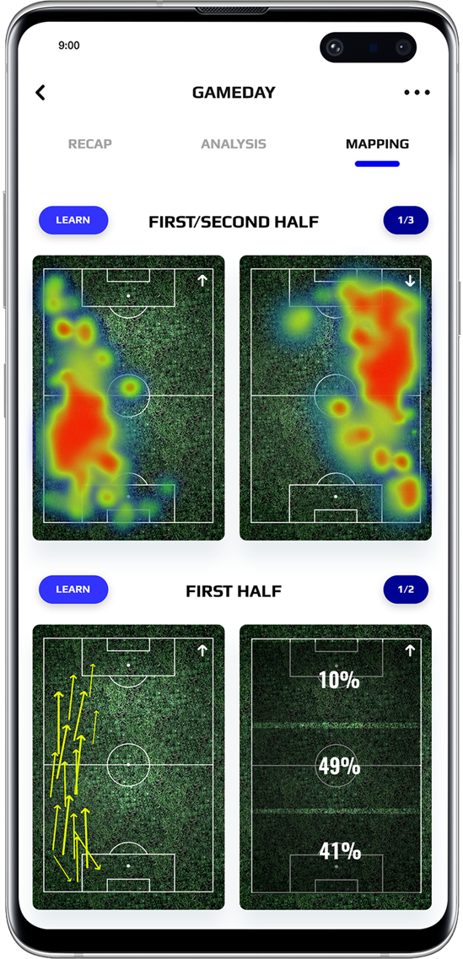
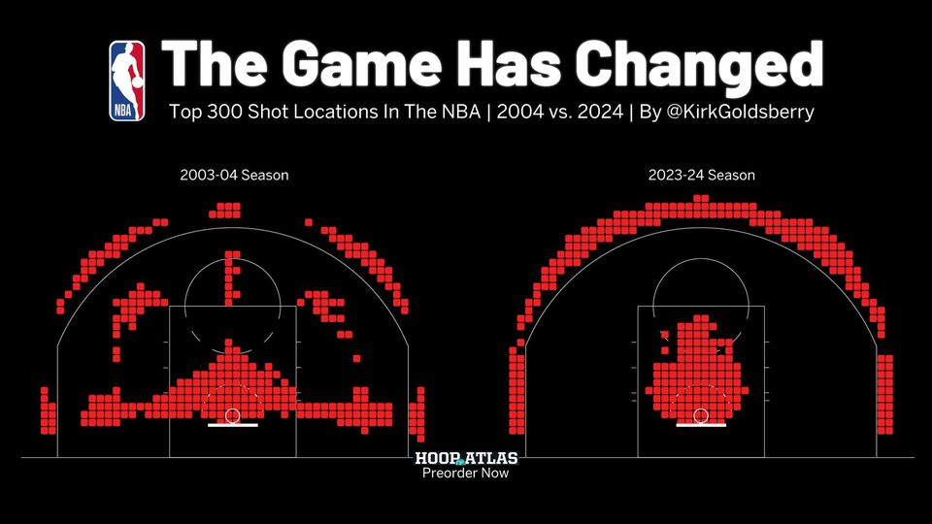
And some example pictures…

Slide 9
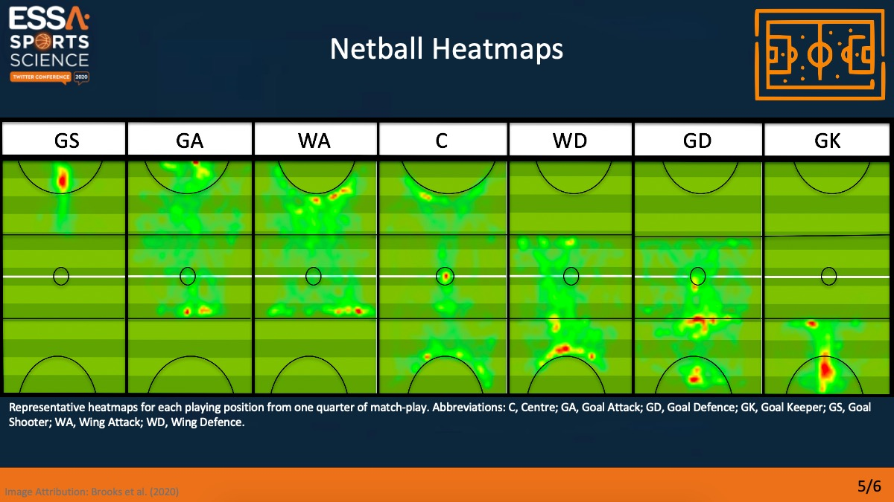
And more examples…

Slide 10





Useful Delayed Video Feed Apps
Video Delay Instant Replay
BaM Video Delay
Please note - Both versions of ‘Video Delay Instant Replay’ are available @ the App Store
Video Delay Instant Replay PRO

Slide 11
So what have we done to try and develop the Game Sense of our students @ MRGS
Note - today we are using Badminton as the movement context.
“A session without a purpose, is a wasted opportunity”
03

Slide 12

Based on ‘4 key ingredients’ to High Performance Sport:
(Taken from the NZ Football framework)
Technical
Tactical
Physical
Mental

Slide 13
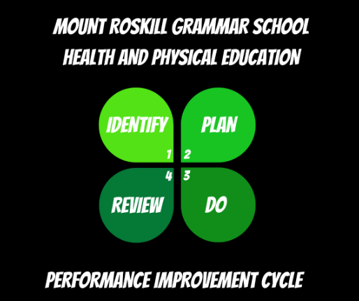
And… Performance Improvement Cycle
Helps us to understand the WHY we collect Data?
Using data enables us to teach students how to REVIEW and IDENTIFY the next steps in their own learning.
  It may not just be a lack of ‘Tactical’ understanding, it could also be ‘Technical’ flaws, or even ‘Mental’ / ‘Physical’.
MRGS Performance Improvement Cycle

Slide 14
EXAMPLE…
How are we developing ‘Game Sense’ in our PE programmes?

Slide 15


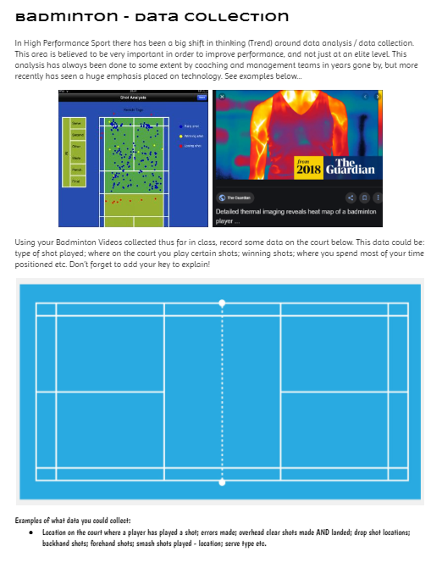
Pitch Mapping
Grab a Badminton ‘Pitch Mapping’ sheet and IDENTIFY what type of ‘Data’ you want to collect.
  Eg. # of Overhead Shots; Drop Shots; Position where you hit the shuttle on the court; Smash locations etc.
Then work out your own ‘key’ and get to work!!!

Slide 16
Most obstacles disappear when we make up our minds to fix them!

Slide 17



